Slide 1


Predicting Mortality From Heart Attacks
Brandon Lloyd Shields
Advanced Machine Learning
Kent State University

Slide 2

PROBLEM
Cardiovascular disease is the number one cause of death globally
Can behavioral and health risks help predict the likelihood of a death event?
The ability to predict could help save lives

Slide 3
Understanding the Data
Data comes from Davide Chicco and Giuseppe Jurman in 2020
Dataset contains 12 features ( i.e. age, sex, smoking, sodium) and the target variable is whether the patient died.
Total of 299 observations

Slide 4
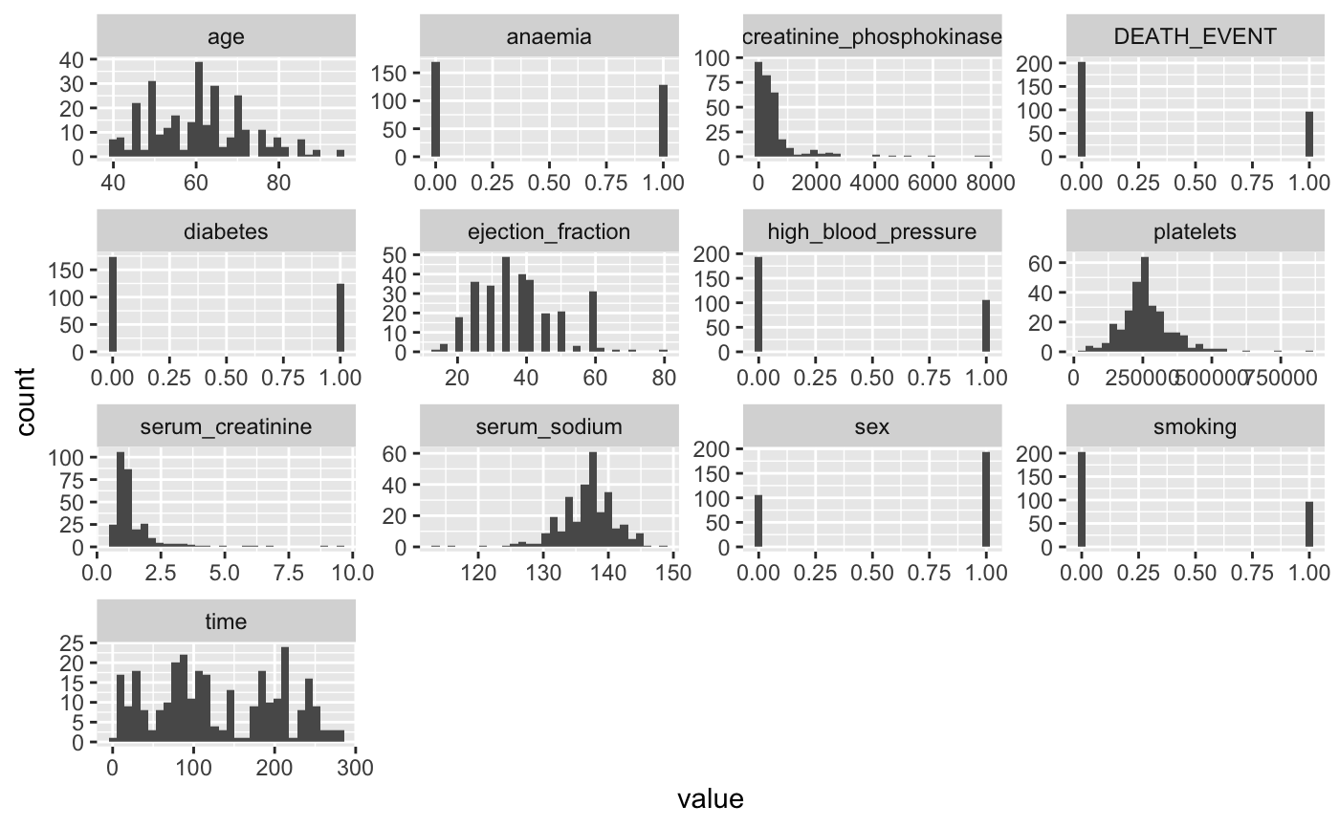
Exploratory Data Analysis
Unbalanced data set will need to be considered in training.
Unbalanced in terms of gender

Slide 5
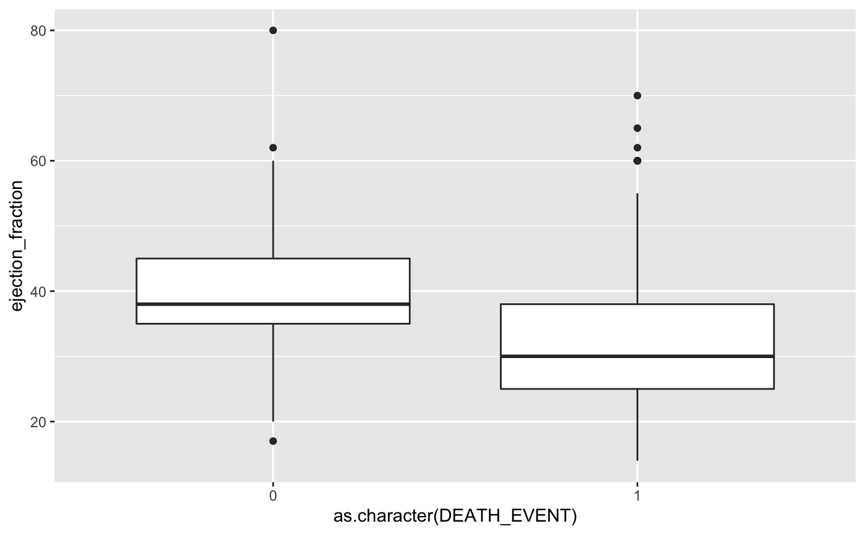
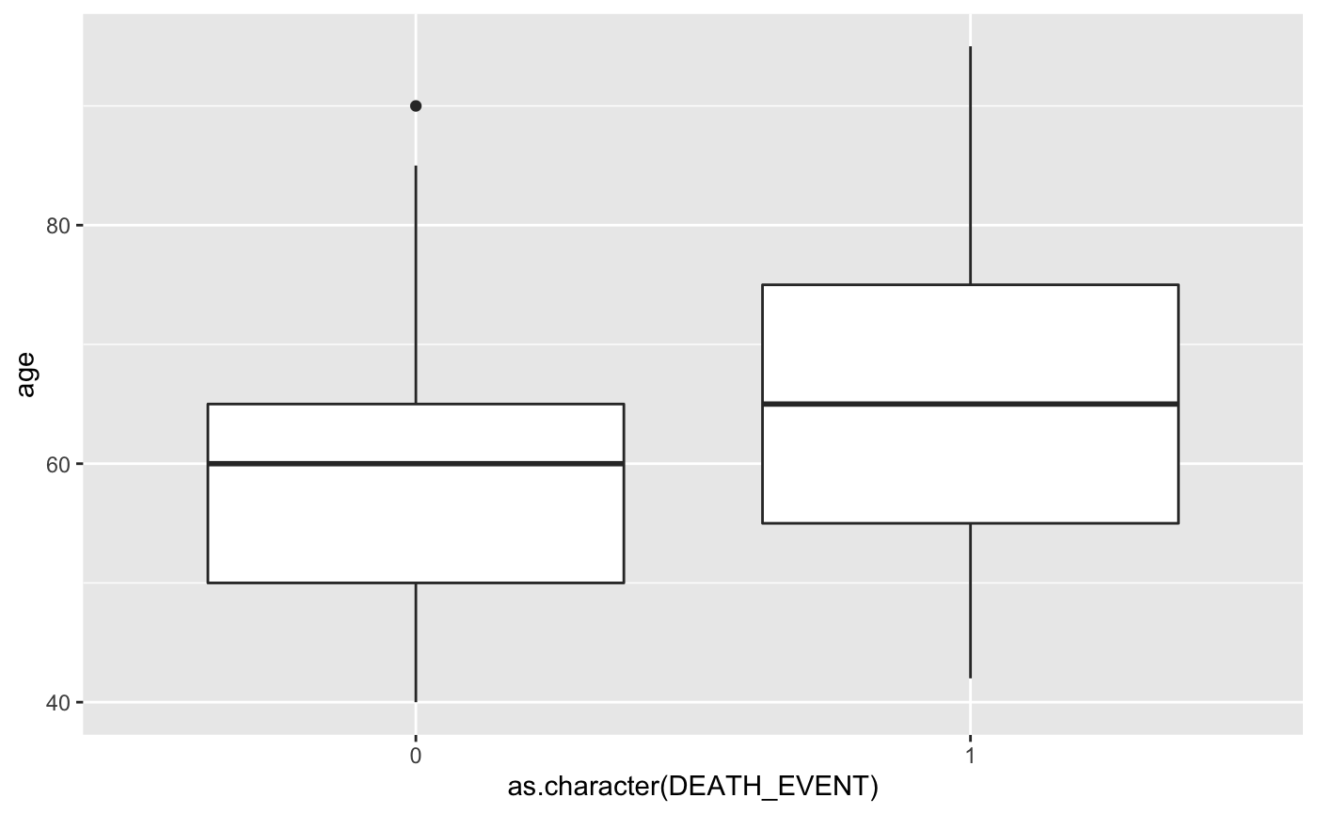
Exploratory Data Analysis

Slide 6
Setup for Training and Validation
Neural network for binary classification problem
80% of data used for training and validation (stratified)
K-fold cross validation used due to small dataset
Call backs used to limit overfitting

Slide 7
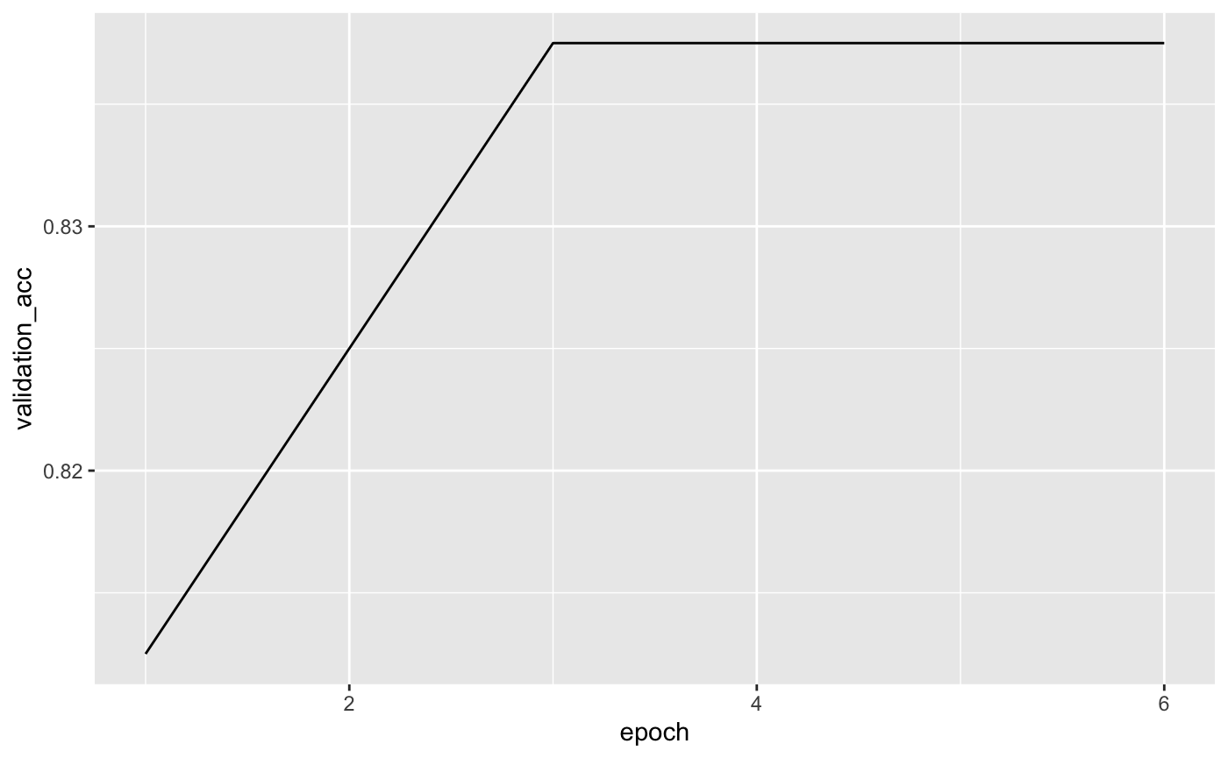
Model Development
Dense Layer - 32 units
Dropout Layer - .5 Rate
Dense Layer - 8 units
Activation Layer - Sigmoid

Slide 8
Model Evaluation
Validation accuracy equals 85% and test accuracy is 76% but is accuracy the best measure?
We want to make sure patients at risk of dying are identified – evaluate on recall.
When threshold set to 50%, recall is 55% -when threshold is set to 5% recall is 75%.

Slide 9
Possible Future Modeling Techniques
Stratified k-fold cross validation
Feature engineering
Additional observations for training and testing

